Slide 1


Mindreading and
Joint Action

Slide 2





Slide 3
Theory of mind abilities are widespread

Slide 4
Theory of mind abilities are widespread
18-month-olds point to inform, and predict actions based on false beliefs
(Liszkowski et al 2006)
(Onishi & Baillargeon 2005; Southgate et al 2007)

Slide 5
Theory of mind abilities are widespread
18-month-olds point to inform, and predict actions based on false beliefs
Scrub-jays selectively re-cache their food in ways that deprive competitors of knowledge of its location
(Liszkowski et al 2006)
(Onishi & Baillargeon 2005; Southgate et al 2007)
(Clayton, Dally & Emery 2007)

Slide 6
Theory of mind abilities are widespread
18-month-olds point to inform, and predict actions based on false beliefs
Scrub-jays selectively re-cache their food in ways that deprive competitors of knowledge of its location
Chimpanzees conceal their approach from a competitor’s view, and act in ways that are optimal given what another has seen
(Liszkowski et al 2006)
(Onishi & Baillargeon 2005; Southgate et al 2007)
(Clayton, Dally & Emery 2007)
(Hare, Call & Tomasello 2006)
(Hare, Call & Tomasello 2001)

Slide 7
Theory of mind abilities are widespread
18-month-olds point to inform, and predict actions based on false beliefs
Scrub-jays selectively re-cache their food in ways that deprive competitors of knowledge of its location
Chimpanzees conceal their approach from a competitor’s view, and act in ways that are optimal given what another has seen
(Liszkowski et al 2006)
(Onishi & Baillargeon 2005; Southgate et al 2007)
(Clayton, Dally & Emery 2007)
(Hare, Call & Tomasello 2006)
(Hare, Call & Tomasello 2001)

Slide 8
Theory of mind abilities are widespread
18-month-olds point to inform, and predict actions based on false beliefs
Scrub-jays selectively re-cache their food in ways that deprive competitors of knowledge of its location
Chimpanzees conceal their approach from a competitor’s view, and act in ways that are optimal given what another has seen
(Liszkowski et al 2006)
(Onishi & Baillargeon 2005; Southgate et al 2007)
(Clayton, Dally & Emery 2007)
(Hare, Call & Tomasello 2006)
(Hare, Call & Tomasello 2001)

Slide 9
Theory of mind abilities are widespread
18-month-olds point to inform, and predict actions based on false beliefs
Scrub-jays selectively re-cache their food in ways that deprive competitors of knowledge of its location
Chimpanzees conceal their approach from a competitor’s view, and act in ways that are optimal given what another has seen
Representing perceptions, knowledge states and beliefs is hard

Slide 10
Theory of mind abilities are widespread
18-month-olds point to inform, and predict actions based on false beliefs
Scrub-jays selectively re-cache their food in ways that deprive competitors of knowledge of its location
Chimpanzees conceal their approach from a competitor’s view, and act in ways that are optimal given what another has seen
Representing perceptions, knowledge states and beliefs is hard, for it requires
(a) conceptual sophistication
- takes years to develop
- development tied to acquisition of executive function and language
- development facilitated by training and siblings

Slide 11
Theory of mind abilities are widespread
18-month-olds point to inform, and predict actions based on false beliefs
Scrub-jays selectively re-cache their food in ways that deprive competitors of knowledge of its location
Chimpanzees conceal their approach from a competitor’s view, and act in ways that are optimal given what another has seen
Representing perceptions, knowledge states and beliefs is hard, for it requires
(a) conceptual sophistication
- takes years to develop
- development tied to acquisition of executive function and language
- development facilitated by training and siblings
(b) scarce cognitive resources
- attention
- working memory

Slide 12
Theory of mind abilities are widespread
18-month-olds point to inform, and predict actions based on false beliefs
Scrub-jays selectively re-cache their food in ways that deprive competitors of knowledge of its location
Chimpanzees conceal their approach from a competitor’s view, and act in ways that are optimal given what another has seen
Representing perceptions, knowledge states and beliefs is hard, for it requires
(a) conceptual sophistication
- takes years to develop
- development tied to acquisition of executive function and language
- development facilitated by training and siblings
(b) scarce cognitive resources
- attention
- working memory

Slide 13
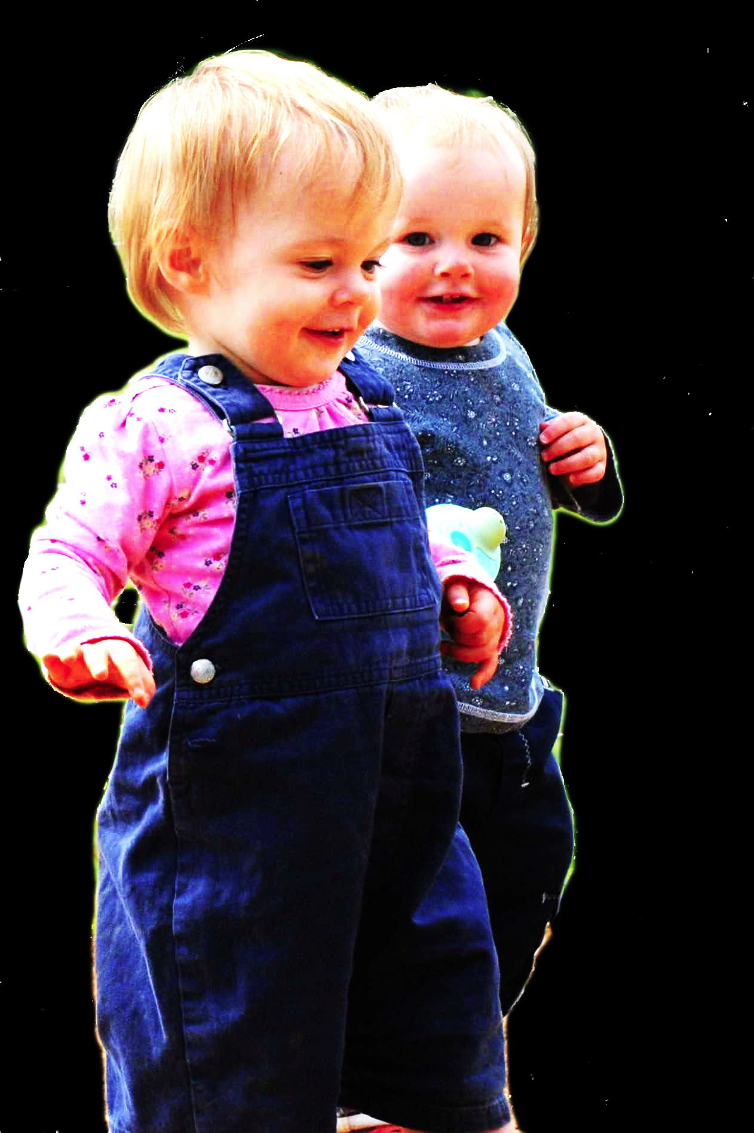
first
What could infants, chimps and scrub-jays represent that would enable them, within limits, to track others’ perceptions, knowledge, beliefs and other propositional attitudes?
question

Slide 14




first
What could infants, chimps and scrub-jays represent that would enable them, within limits, to track others’ perceptions, knowledge, beliefs and other propositional attitudes?
question

Slide 15
Intentional relation
e.g. She is interested in that chocolate
e.g. She is smiling at me
Propositional attitude
e.g. She believes that the chocolate is in that cupboard

Slide 16

Your field = a set of objects related to you by proximity, orientation, lighting and other factors
You encounter an object = it is in your field
You register an object at a location = you most recently encountered the object at that location

Slide 17
Your field = a set of objects related to you by proximity, orientation, lighting and other factors
You encounter an object = it is in your field
You register an object at a location = you most recently encountered the object at that location
proximity
orientation
lighting
barriers
trajectory

Slide 18
Your field = a set of objects related to you by proximity, orientation, lighting and other factors
You encounter an object = it is in your field
You register an object at a location = you most recently encountered the object at that location
proximity
orientation
lighting
barriers
trajectory

Slide 19
Your field = a set of objects related to you by proximity, orientation, lighting and other factors
You encounter an object = it is in your field
You register an object at a location = you most recently encountered the object at that location
Principle 1: one can’t goal-directedly act on an object unless one has encountered it.
Principle 2: correct registration is a condition of successful action.
Principle 3: when an agent performs a goal-directed action and the goal specifies an object, the agent will act as if the object were actually in the location she registers it at.
proximity
orientation
lighting
barriers
trajectory

Slide 20
Your field = a set of objects related to you by proximity, orientation, lighting and other factors
You encounter an object = it is in your field
You register an object at a location = you most recently encountered the object at that location
Principle 1: one can’t goal-directedly act on an object unless one has encountered it.
Principle 2: correct registration is a condition of successful action.
Principle 3: when an agent performs a goal-directed action and the goal specifies an object, the agent will act as if the object were actually in the location she registers it at.
proximity
orientation
lighting
barriers
trajectory

Slide 21
Your field = a set of objects related to you by proximity, orientation, lighting and other factors
You encounter an object = it is in your field
You register an object at a location = you most recently encountered the object at that location
Principle 1: one can’t goal-directedly act on an object unless one has encountered it.
Principle 2: correct registration is a condition of successful action.
Principle 3: when an agent performs a goal-directed action and the goal specifies an object, the agent will act as if the object were actually in the location she registers it at.
proximity
orientation
lighting
barriers
trajectory

Slide 22
Your field = a set of objects related to you by proximity, orientation, lighting and other factors
You encounter an object = it is in your field
You register an object at a location = you most recently encountered the object at that location
Principle 1: one can’t goal-directedly act on an object unless one has encountered it.
Principle 2: correct registration is a condition of successful action.
Principle 3
proximity
orientation
lighting
barriers
trajectory

Slide 23
Your field = a set of objects related to you by proximity, orientation, lighting and other factors
You encounter an object = it is in your field
You register an object at a location = you most recently encountered the object at that location
Principle 1: one can’t goal-directedly act on an object unless one has encountered it.
Principle 2: correct registration is a condition of successful action.
Principle 3: when an agent performs a goal-directed action and the goal specifies an object, the agent will act as if the object were actually in the location she registers it at.
proximity
orientation
lighting
barriers
trajectory

Slide 24

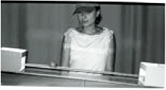
source Träuble, Marinovic, & Pauen (2010)

Slide 25
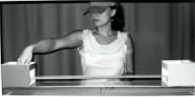
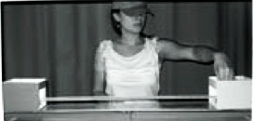
source Träuble, Marinovic, & Pauen (2010)

Slide 26
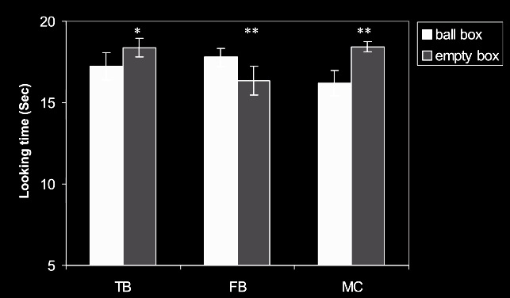
source Träuble, Marinovic, & Pauen (2010)

Slide 27
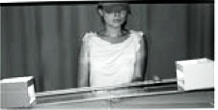
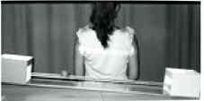
source Träuble, Marinovic, & Pauen (2010)

Slide 28
source Träuble, Marinovic, & Pauen (2010)

Slide 29
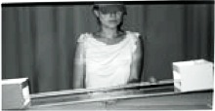
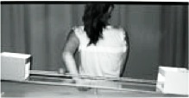
source Träuble, Marinovic, & Pauen (2010)

Slide 30
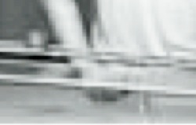
source Träuble, Marinovic, & Pauen (2010)

Slide 31
source Träuble, Marinovic, & Pauen (2010)

Slide 32
Your field = a set of objects related to you by proximity, orientation, lighting and other factors
You encounter an object = it is in your field
You register an object at a location = you most recently encountered the object at that location
Principle 1: one can’t goal-directedly act on an object unless one has encountered it.
Principle 2: correct registration is a condition of successful action.
Principle 3: when an agent performs a goal-directed action and the goal specifies an object, the agent will act as if the object were actually in the location she registers it at.
proximity
orientation
lighting
barriers
trajectory

Slide 33
Your field = a set of objects related to you by proximity, orientation, lighting and other factors
You encounter an object = it is in your field
You register an object at a location = you most recently encountered the object at that location
Principle 1: one can’t goal-directedly act on an object unless one has encountered it.
Principle 2: correct registration is a condition of successful action.
Principle 3: when an agent performs a goal-directed action and the goal specifies an object, the agent will act as if the object were actually in the location she registers it at.
proximity
orientation
lighting
barriers
trajectory

Slide 34
Principle 2: correct registration is a condition of successful action.
source Träuble, Marinovic, & Pauen (2010)

Slide 35
signature limits

Slide 36
1. Charly is Samantha
2. Mitch believes that Charly is in Baltimore
3. Mitch believes that Samantha is in Baltimore
(1) & (2) ⇒ (3)

Slide 37
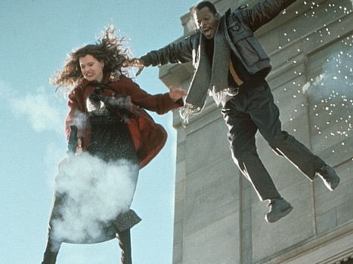
1. Charly is Samantha
2. Mitch believes that Charly is in Baltimore
3. Mitch believes that Samantha is in Baltimore
(1) & (2) ⇒ (3)

Slide 38
1. Charly is Samantha
2. Mitch believes that Charly is in Baltimore
3. Mitch believes that Samantha is in Baltimore
(1) & (2) ⇒ (3)
4. Mitch registers <Charly, Baltimore>
5. Mitch registers <Samantha, Baltimore>
(1) & (4) ⇒ (5)

Slide 39
False belief about location
False belief about identity
Subjects represent registration
Subjects represent beliefs
pass
fail
pass
pass

Slide 40
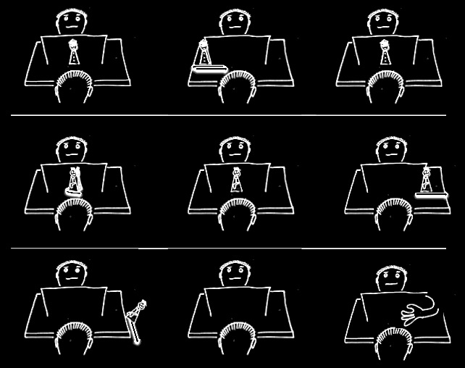

Slide 45


Slide 46


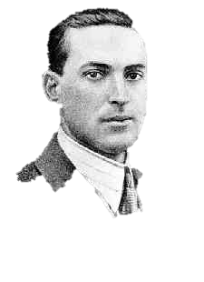
“the unique aspects of human cognition ... were driven by, or even constituted by, social co-operation”
(Moll & Tomasello 2007)
“perception, action, and cognition are grounded in social interaction”
(Sebanz & Knoblich 2008)

Slide 47
tidying up the toys together
(Behne et al 2005)
cooperatively pulling handles in sequence to make a dog-puppet sing
(Brownell et al 2006)
bouncing a ball on a large trampoline together
(Tomasello & Carpenter 2007)
pretending to row a boat together

Slide 48

second
Which theory of mind cognition is required for joint action?
question

Slide 49
shared intention

Slide 50
‘I take a collective action to involve a collective [shared] intention.’
(Gilbert 2006, p. 5)
‘The sine qua non of collaborative action is a joint goal [shared intention] and a joint commitment’
(Tomasello 2008, p. 181)
‘the key property of joint action lies in its internal component [...] in the participants’ having a “collective” or “shared” intention.’
(Alonso 2009, pp. 444-5)
‘Shared intentionality is the foundation upon which joint action is built.’
(Carpenter 2009, p. 381)

Slide 51
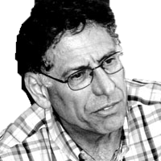
We have a shared intention that we J =
“1. (a) I intend that we J and (b) you intend that we J
“2. I intend that we J in accordance with and because of la, lb, and meshing subplans of la and lb; you intend [likewise] …
“3. 1 and 2 are common knowledge between us”
(Bratman 1993: View 4)

Slide 52
We have a shared intention that we J =
“1. (a) I intend that we J and (b) you intend that we J
“2. I intend that we J in accordance with and because of la, lb, and meshing subplans of la and lb; you intend [likewise] …
“3. 1 and 2 are common knowledge between us”
(Bratman 1993: View 4)
{
Intentions about intentions

Slide 53
We have a shared intention that we J =
“1. (a) I intend that we J and (b) you intend that we J
“2. I intend that we J in accordance with and because of la, lb, and meshing subplans of la and lb; you intend [likewise] …
“3. 1 and 2 are common knowledge between us”
(Bratman 1993: View 4)
{
Intentions about intentions
{
Knowledge of others’ knowledge of intentions about intentions

Slide 54
1. All (significant) joint actions require shared intention.
2. Shared intention requires sophisticated theory of mind cognition.
Therefore:
3. Abilities to engage in joint action could play no significant role in explaining the emergence, in evolution or development, of mindreading.

Slide 55
1. All (significant) joint actions require shared intention.
2. Shared intention requires sophisticated theory of mind cognition.
Therefore:
3. Abilities to engage in joint action could play no significant role in explaining the emergence, in evolution or development, of mindreading.

Slide 56
1. All (significant) joint actions require shared intention.
2. Shared intention requires sophisticated theory of mind cognition.
Therefore:
3. Abilities to engage in joint action could play no significant role in explaining the emergence, in evolution or development, of mindreading.

Slide 57
Joint action:
an event with two or more agents (Ludwig 2007)

Slide 58
Joint action:
an event with two or more agents (Ludwig 2007)
Nora’s shooting
Fred’s death
Olive’s shooting
Fred’s killing

Slide 59
Joint action:
an event with two or more agents (Ludwig 2007)
tidying up the toys together
(Behne et al 2005)
cooperatively pulling handles in sequence to make a dog-puppet sing
(Brownell et al 2006)
bouncing a ball on a large trampoline together
(Tomasello & Carpenter 2007)
pretending to row a boat together
Nora’s shooting
Fred’s death
Olive’s shooting
Fred’s killing

Slide 60
Goal-directed joint action: an event with two or more agents which, taken as a whole, is directed to a goal.

Slide 61

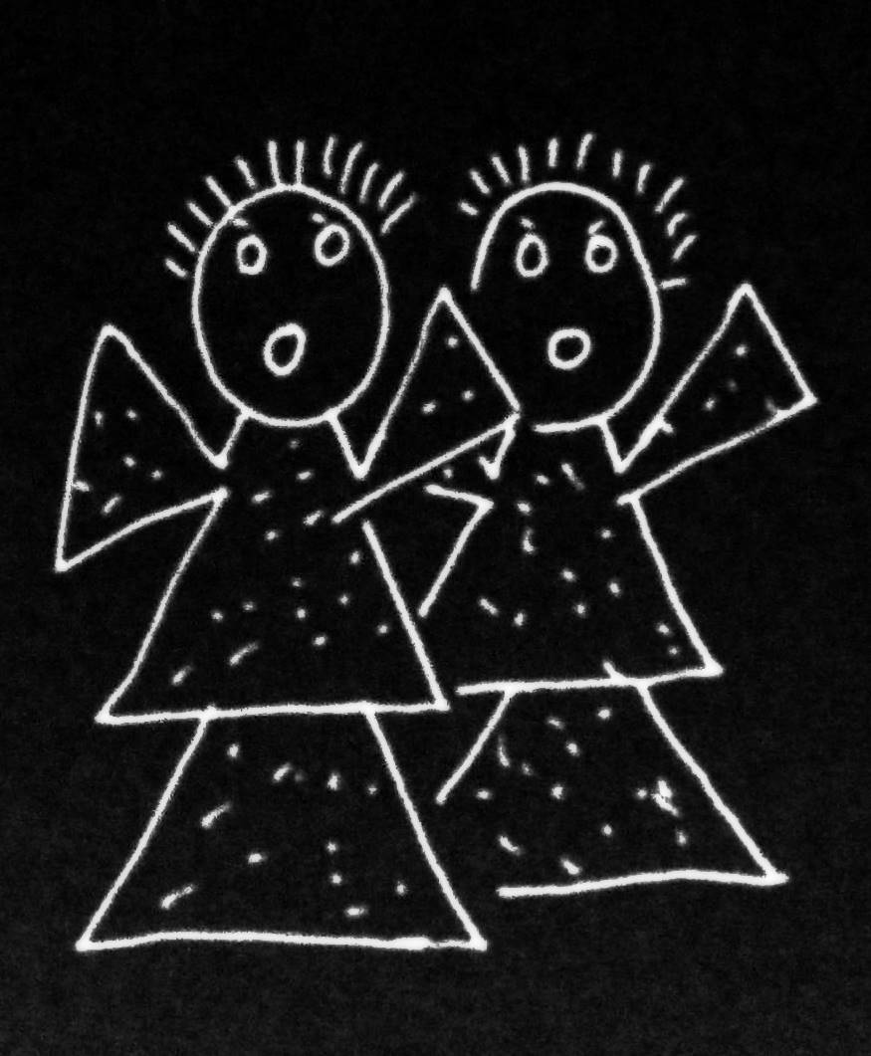
Goal-directed joint action: an event with two or more agents which, taken as a whole, is directed to a goal.

Slide 62
Goal-directed joint action: an event with two or more agents which, taken as a whole, is directed to a goal.
out
out
act
out
act
out

Slide 63
Goal-directed joint action: an event with two or more agents which, taken as a whole, is directed to a goal.
out
out
act
represents
coordinates
out
act
shared intention
out

Slide 64
Goal-directed joint action: an event with two or more agents which, taken as a whole, is directed to a goal.
???
out
out
act
represents
coordinates
out
act
shared intention
out

Slide 65
Goal-directed joint action: an event with two or more agents which, taken as a whole, is directed to a goal.
G is a distributive goal: it is an outcome to which each agent’s activities are individually directed and it is possible that: all agents succeed relative to this outcome.

Slide 66
Goal-directed joint action: an event with two or more agents which, taken as a whole, is directed to a goal.
G is a distributive goal: it is an outcome to which each agent’s activities are individually directed and it is possible that: all agents succeed relative to this outcome.
G is a collective goal
(a) it is a distributive goal;
(b) the agents’ activities are coordinated; and
(c) coordination of this type would normally facilitate occurrences of outcomes of this type.

Slide 67
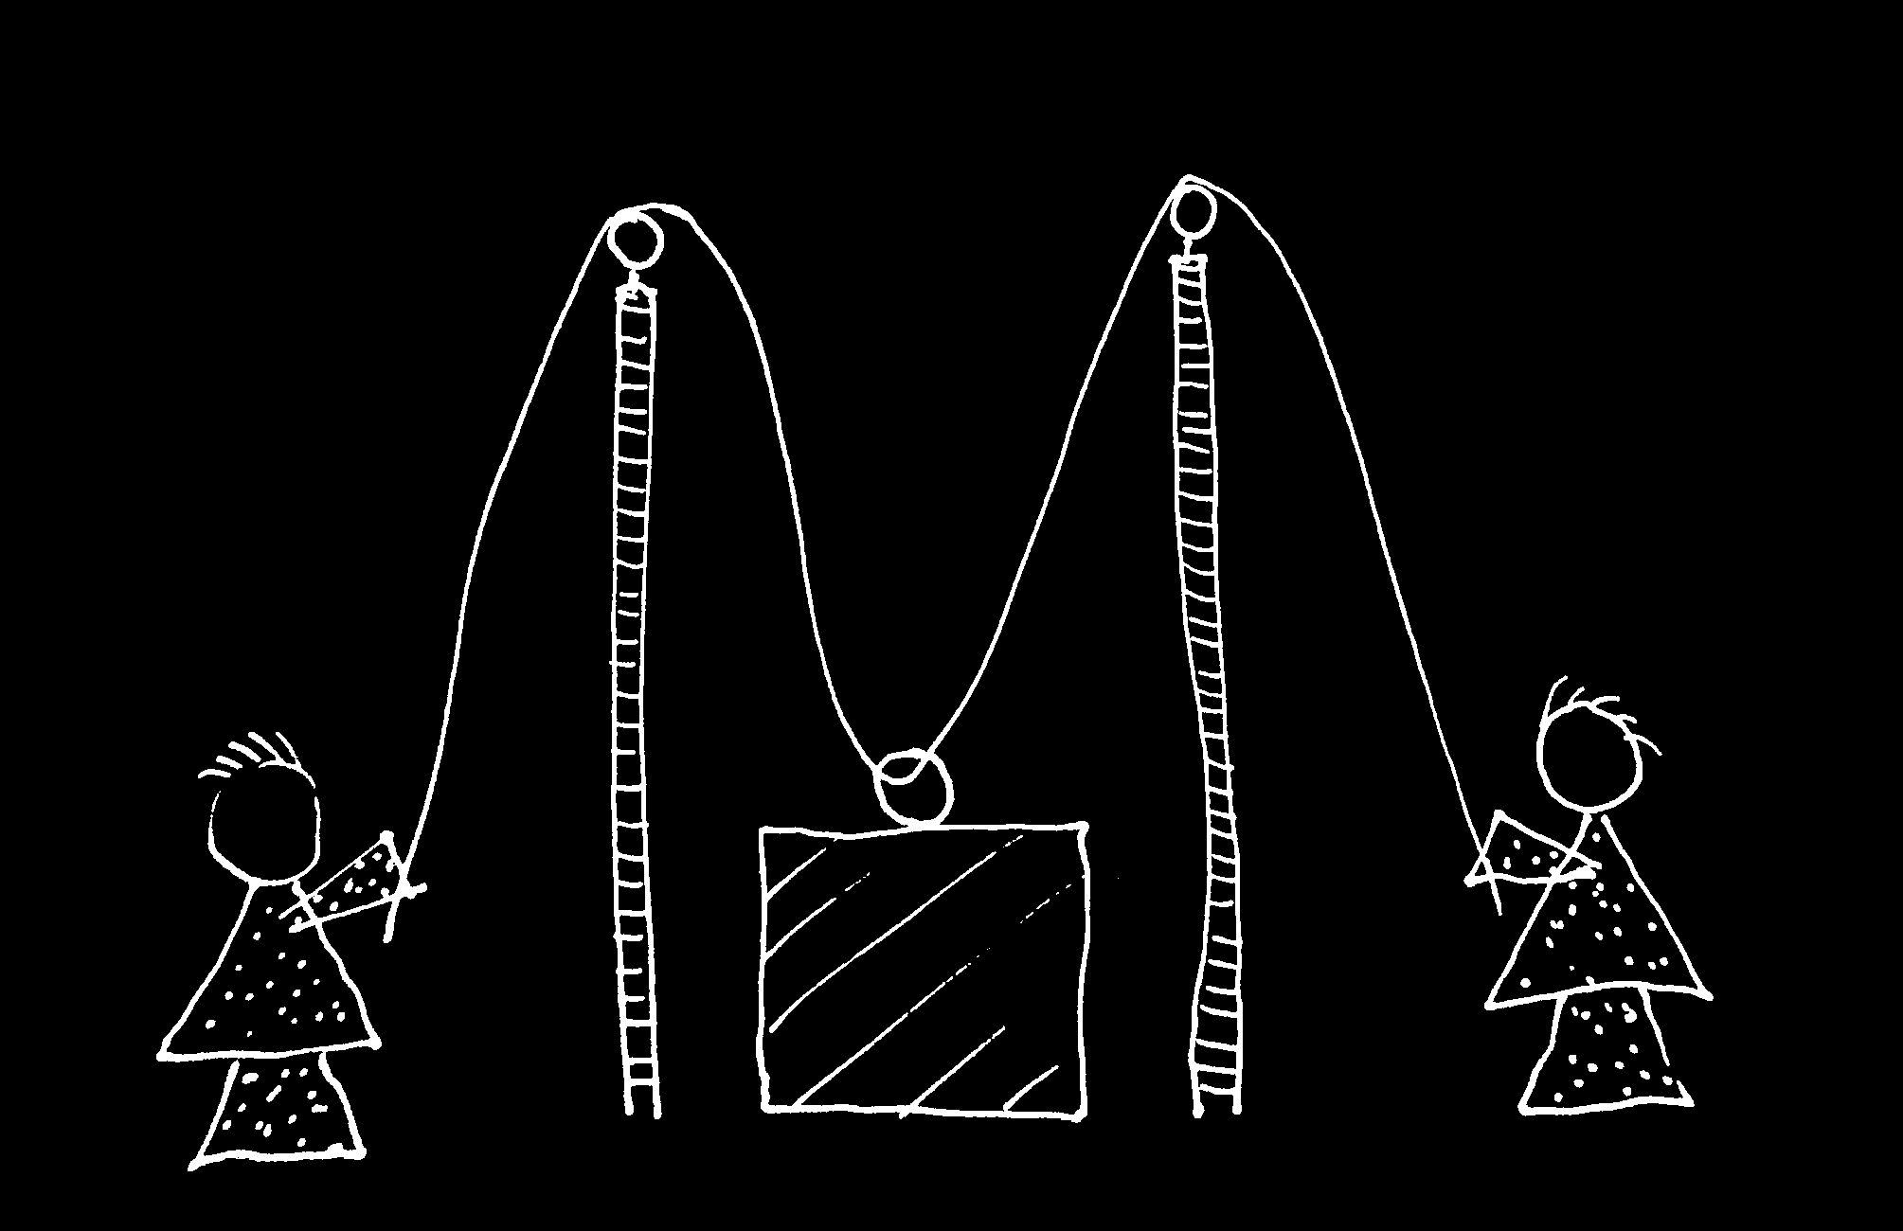

Slide 68
Goal-directed joint action: an event with two or more agents which, taken as a whole, is directed to a goal.
G is a distributive goal: it is an outcome to which each agent’s activities are individually directed and it is possible that: all agents succeed relative to this outcome.
G is a collective goal
(a) it is a distributive goal;
(b) the agents’ activities are coordinated; and
(c) coordination of this type would normally facilitate occurrences of outcomes of this type.

Slide 69
Goal-directed joint action: an event with two or more agents which, taken as a whole, is directed to a goal.
G is a distributive goal: it is an outcome to which each agent’s activities are individually directed and it is possible that: all agents succeed relative to this outcome.
G is a collective goal
(a) it is a distributive goal;
(b) the agents’ activities are coordinated; and
(c) coordination of this type would normally facilitate occurrences of outcomes of this type.

Slide 70
Goal-directed joint action: an event with two or more agents which, taken as a whole, is directed to a goal.
G is a distributive goal: it is an outcome to which each agent’s activities are individually directed and it is possible that: all agents succeed relative to this outcome.
G is a shared goal
G is a collective goal
(a) it is a distributive goal;
(b) the agents’ activities are coordinated; and
(c) coordination of this type would normally facilitate occurrences of outcomes of this type.
Each agent expects each of the other agents to perform activities directed to the goal.
Each agent expects the goal to occur as a common effect of all their goal-directed actions.

Slide 71

third
question
Notes:
This is an overview of the project and its aims

Slide 72
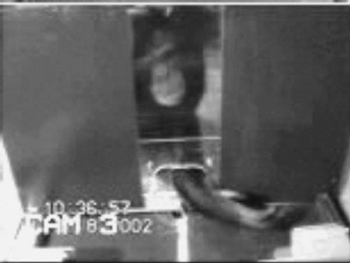

failed reach
point
source: Hare & Tomasello (2004)
Notes:
this illustrates problem of identifying particular goals of action

Slide 73
The problem of opaque means

Slide 74
The problem of false belief

Slide 75
your-goal-is-my-goal

Slide 76
your-goal-is-my-goal
1. We are about to engage in some joint action* or other
2. I am not about to change my goal.
Therefore:
3. Your actions also will be directed to this goal.
[*in at least the minimal sense associated with distributive goals]

Slide 77
failed reach
point
source: Hare & Tomasello (2004)

Slide 78
failed reach
point
source: Hare & Tomasello (2004)
“to understand pointing, the subject needs to understand more than the individual goal-directed behaviour. She needs to understand that ... the other attempts to communicate to her ... and ... the communicative intention behind the gesture”
(Moll & Tomsello 2007)

Slide 79
failed reach
point
source: Hare & Tomasello (2004)
“to understand pointing, the subject needs to understand more than the individual goal-directed behaviour. She needs to understand that ... the other attempts to communicate to her ... and ... the communicative intention behind the gesture”
(Moll & Tomsello 2007)

Slide 80
Csibra’s ‘two stances’:
Teleological and referential action interpretation ‘rely on different kinds of action understanding’
These are initially two distinct ‘action interpretation systems’ and they come together later in development
Csibra (2003, p. 456)

Slide 81

minimal theory of mind cognition
joint action (ability to share goals)
understanding communicative intent
other stuff
communication by language
other stuff
full-blown theory of mind cognition

Slide 83
Joint action:
an event with two or more agents (Ludwig 2007)
Goal-directed joint action:
a joint action which, taken as a whole, is directed to a goal
Nora’s shooting
Fred’s death
Olive’s shooting
Fred’s killing

Slide 84
What is the relation between an action and the goal (or goals) to which it is directed?

Slide 85
What is the relation between an action and the goal (or goals) to which it is directed?

Slide 86
What is the relation between an action and the goal (or goals) to which it is directed?
out
out
act
out
out

Slide 87
What is the relation between an action and the goal (or goals) to which it is directed?
out
out
act
(goal)
out
out

Slide 88
What is the relation between an action and the goal (or goals) to which it is directed?
out
out
act
represents
coordinates
(goal)
out
intention or other goal-state
out

Slide 89
What is the relation between an action and the goal (or goals) to which it is directed?
teleological function
out
out
act
represents
coordinates
out
intention or other goal-state
out

Slide 90
What is the relation between an action and the goal (or goals) to which it is directed?
teleological function
out
out
act
represents
coordinates
out
intention or other goal-state
It is possible to represent goal-directed actions without representing intentions.
out

Slide 91
out
out
act
out
out

Slide 92
Goal-directed joint action: an event with two or more agents which, taken as a whole, is directed to a goal.
out
out
act
out
out

Slide 94
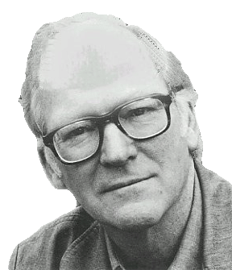
“We are stuck with our two main ways of describing and explaining things, one which treats objects and events as mindless, and the other which treats objects and events as having propositional attitudes. I see no way of bridging the gap by introducing an intermediate vocabulary.”
(Davidson 2003: 697)

Slide 95
“We are stuck with our two main ways of describing and explaining things, one which treats objects and events as mindless, and the other which treats objects and events as having propositional attitudes. I see no way of bridging the gap by introducing an intermediate vocabulary.”
(Davidson 2003: 697)

Slide 97
Joint action:
an event with two or more agents (Ludwig 2007)

Slide 98
Joint action:
an event with two or more agents (Ludwig 2007)
Nora’s shooting
Fred’s death
Olive’s shooting
Fred’s killing

Slide 99
Joint action:
an event with two or more agents (Ludwig 2007)
tidying up the toys together
(Behne et al 2005)
cooperatively pulling handles in sequence to make a dog-puppet sing
(Brownell et al 2006)
bouncing a ball on a large trampoline together
(Tomasello & Carpenter 2007)
pretending to row a boat together
Nora’s shooting
Fred’s death
Olive’s shooting
Fred’s killing

Slide 100
Grounding
events D₁, ... D_{n} ground E, if:
D₁, ... D_{n} and E occur;
D₁, ... D_{n} are each (perhaps improper) parts of E; and
every event that is a proper part of E but is not a part of any of D₁,...D_{n} nor of any event consisting only in some or all of D₁, ... D_{n} is caused by some or all of D₁, ... D_{n}.
Agency
For an individual to be among the agents of an event is for there to be actions a₁, ... a_{n} which ground this event where the individual is an agent of one or more of these actions.
(Adapted from Pietroski 1998)

